Slide 1
WAGES AND INCENTIVES
FACULTY: YADHU G

Slide 2

WAGES AND INCENTIVES
Salary is a fixed amount paid or transferred to the employees at regular intervals at the end of the month.
Wages are hourly or daily-based payment given to the labour for the amount of work finished in a day.
Incentive is an additional reward an employee gets when doing the job better

Slide 3
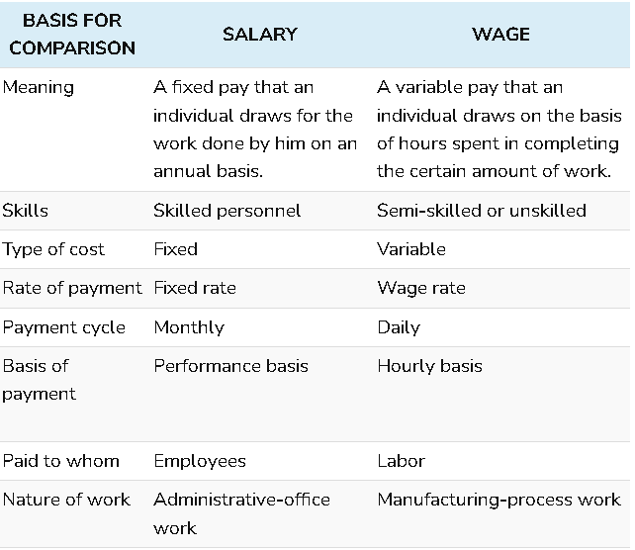

Slide 4
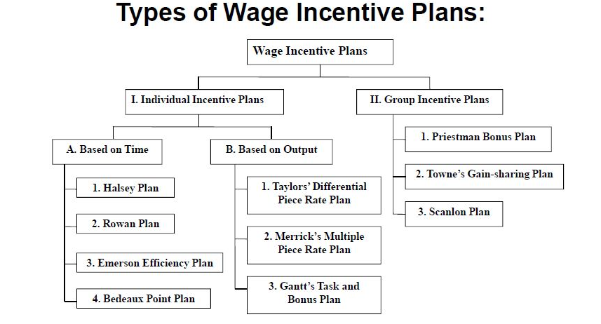

Slide 5
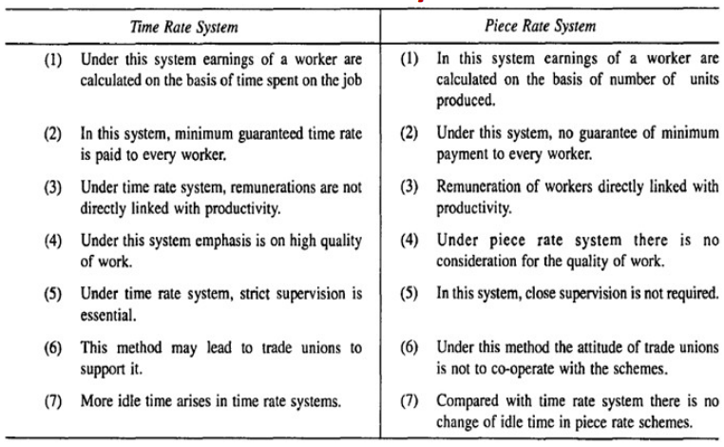

Slide 6
50-50 HALSEY PLAN
Minimum wage is guaranteed.
Bonus for fixed amount of time saved.
A standard time is fixed for the workers. If the workers finish the work before standard time they are given bonus. But no penalty if they fails to do that.
Both the employer and the workers are the beneficiary of this system because both share the profits derived from the time saved.
The workers are not given full reward to their efforts. Normally they are paid for half of the time saved and not for full time.

Slide 7
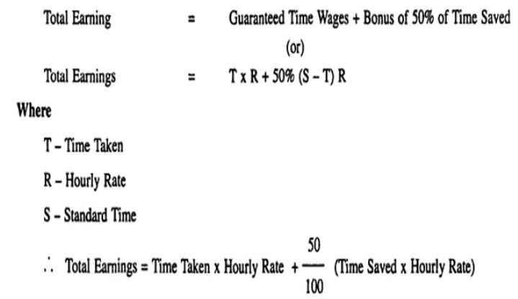
Halsey plan is applied to all workers

Slide 8
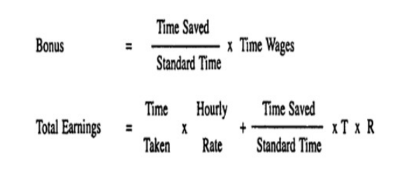
ROWAN PLAN
Minimum wage is guaranteed.
Bonus based on the fixed % of time worked.
Standard time is fixed and the bonus is paid on the basis of time saved
Bonus is paid at decreasing rate.

Slide 9
EMERSON PLAN
Based on efficiency (Output / Standard)
An incentive bonus is paid to the workman of his output exceeds 66.67 % of standard performance.
(2/3) rd of standard performance

Slide 10
BEDEAUX POINT PLAN
75 % incentive to workers and 25% to foreman or supervisor.
Rowan plan = Halsey plan
when Actual time=Standard time/2
Gantt task and bonus scheme
Minimum days wage is guaranteed.

Slide 11


